Slide 1
UPPRESSO方案
Initialization: (G,q)←Setup(1⍵); choosing random P∈G, ID_RP=P; choosing random u∈[0,q), ID_U=u
One-time number generation: choose random n∈[0,q)
PID_RP transformation: calculating PID_RP=nID_RP
PID_U generation: calculating PID_U= ID_U·PID_RP
Account: calculating Account = n⁻¹PID_U

Slide 2
DDH假设
Let G be a cyclic group of prime order q written additively. The two distributions
{P, aP, bP, abP}_{P∈G, 0<=a,b<q}
{P, aP, bP, cP}_{P∈G, 0<=a,b,c<q}
are computationally indistinguishable.
That is, for any PPT distinguishing method(区分算法) D, there is
|Pr[0<=a,b<q:D(P,aP,bP,abP)=1]-Pr[0<=a,b,c<q:D(P,aP,bP,cP)=1]|<negl(n)

Slide 3
Indistinguishability prove
For two authentications in the system, there are two distributions
{ID_RP₁, n₁, PID_U₁=n₁·ID_RP₁·PID_U₁}
{ID_RP₂, n₂, PID_U₂=n₂·ID_RP₂·PID_U₂}
It cannot be confirmed that whether ID_U₁=ID_U₂ as ID_RP₁≠ID_RP₂

Slide 4
Adversary Game₀
Challenger: IdP + users
Adversary: RPs

Slide 5
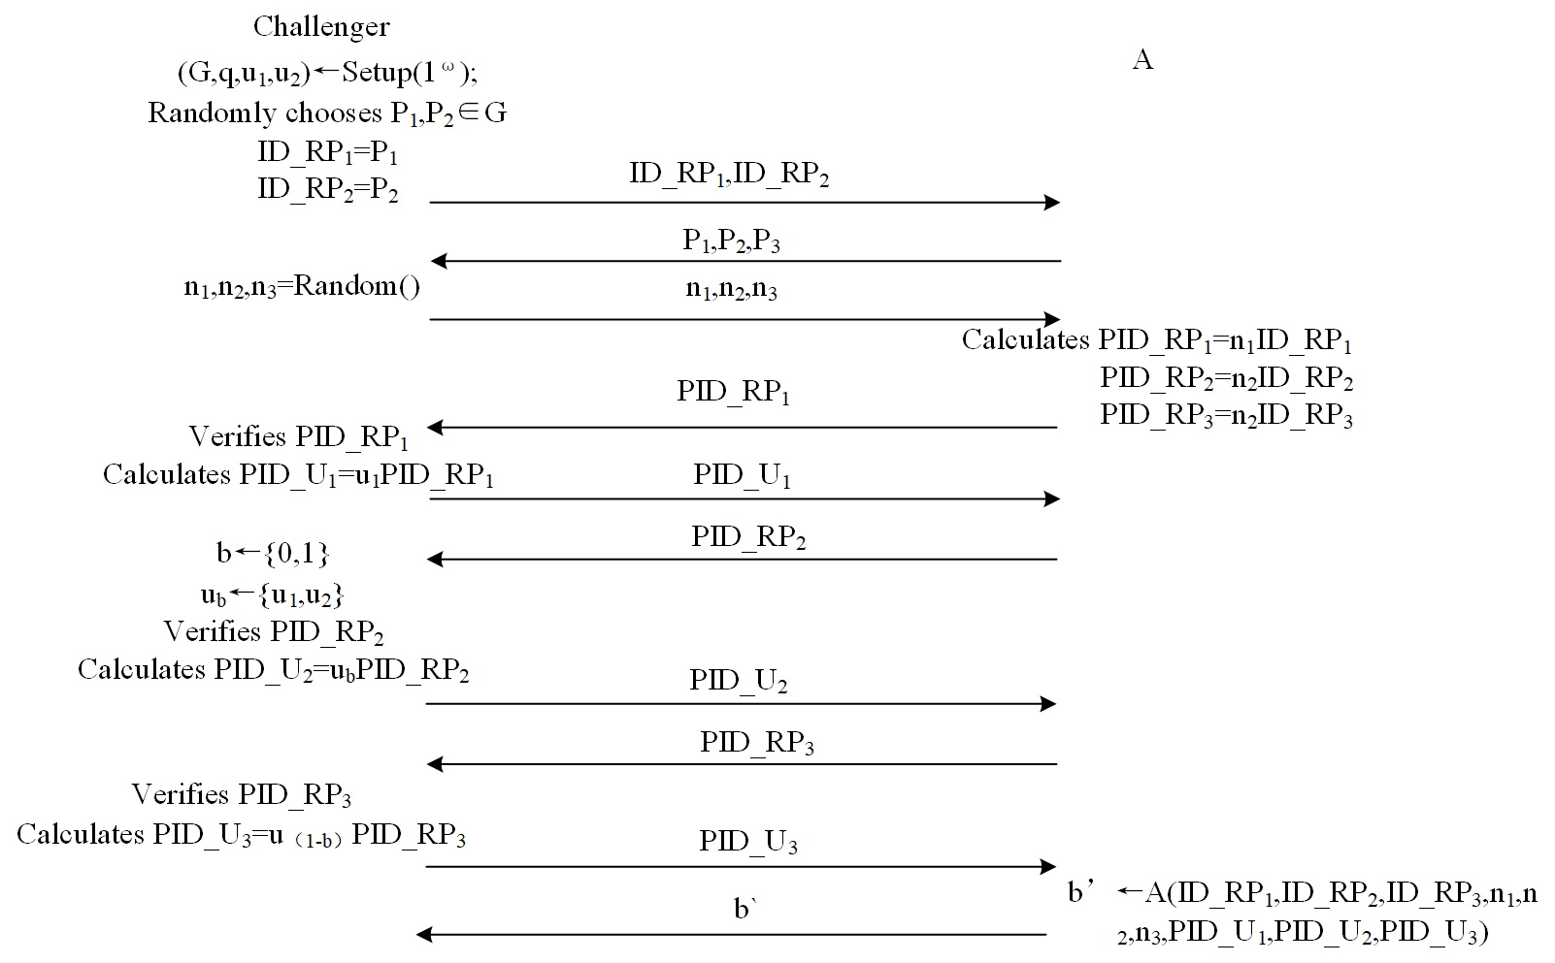
Game0

Slide 6
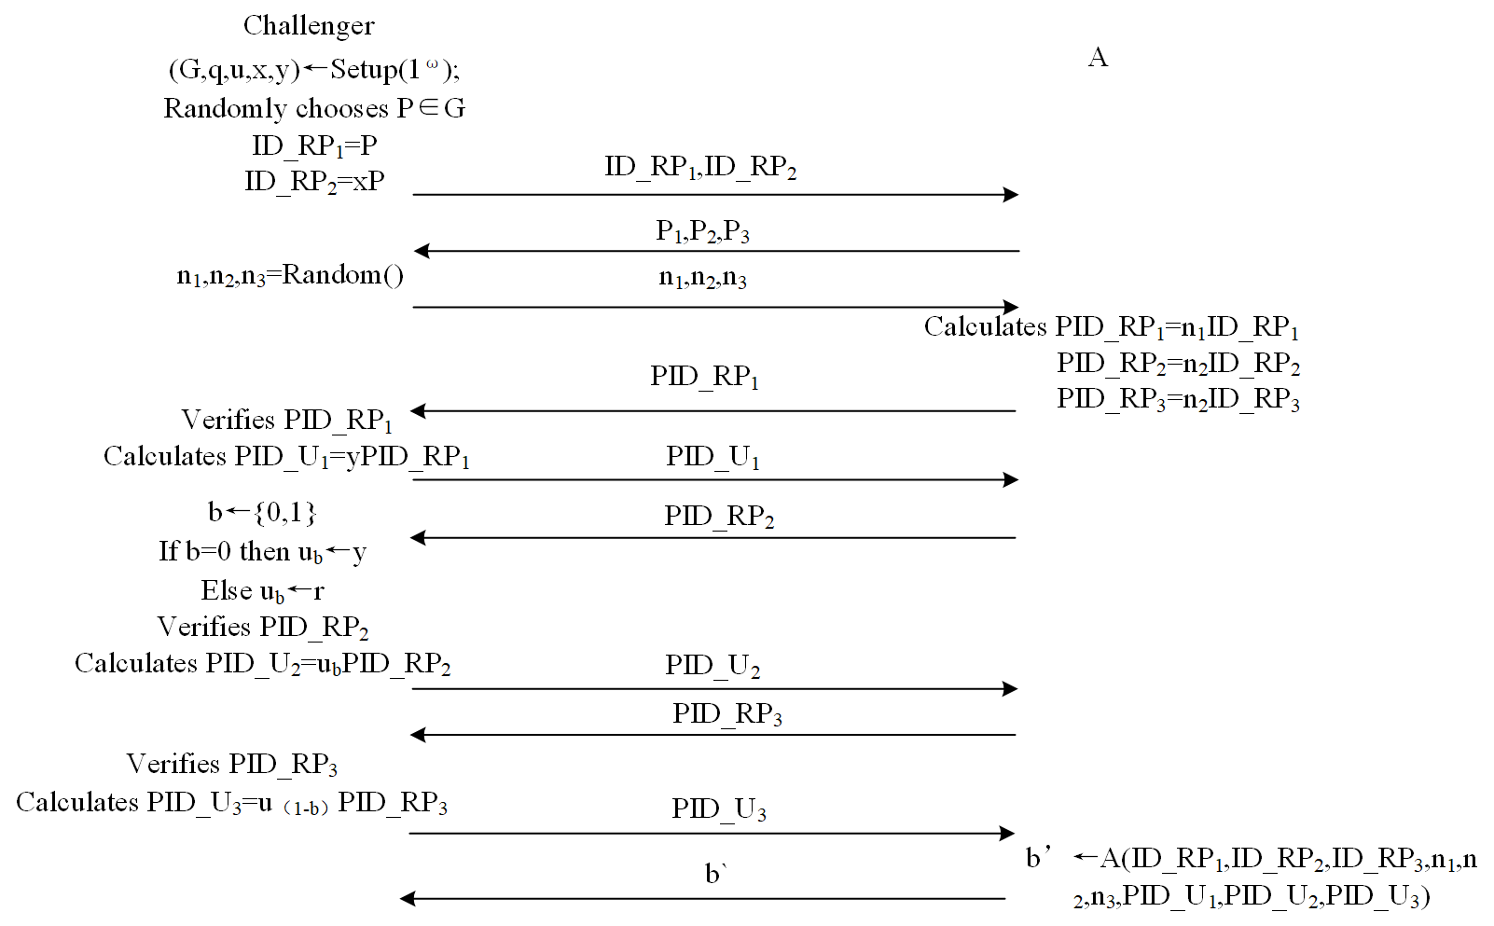
Game1

Slide 7
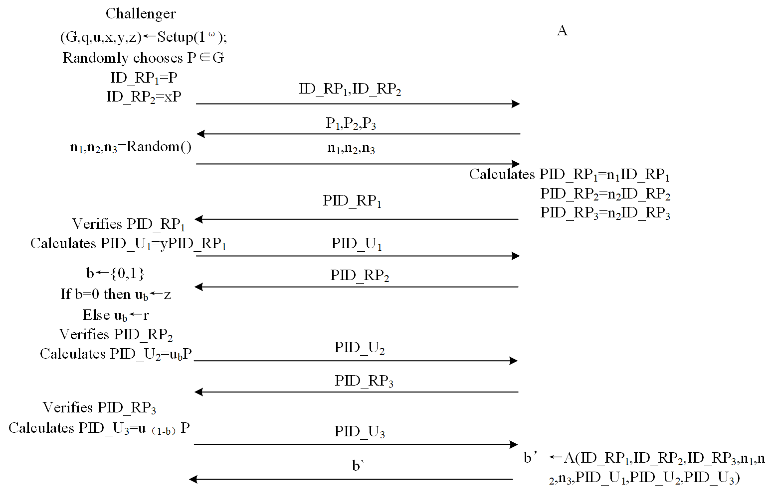
Game2

Slide 8
证明
In Game0, p₁=Pr(b=b`)=1/2
证明过程
In Game2, p₃=Pr(b=b`)=1/2
In Game1, p₂=p₁
p₃-p₂=negl(n)

Slide 9
Game1
b’←A(ID_RP₁,ID_RP₂,ID_RP₂,n₁,n₂,n₃,PID_U₁,PID_U₂,PID_U₃)
A(P,xP,xP,n₁,n₂,n₃,n₁yP,n₂xyP,n₃uxP) or A(P,xP,xP,n₁,n₂,n₃,n₁yP,n₂uxP,n₃xyP)
因为n是随机数并且可以消去，所以转换为
A(P,xP,yP,xyP,uxP)

Slide 10
Game2
b’←A(ID_RP₁,ID_RP₂,ID_RP₂,n₁,n₂,n₃,PID_U₁,PID_U₂,PID_U₃)
转换为A(P,xP,yP,zP,uP)

Slide 11
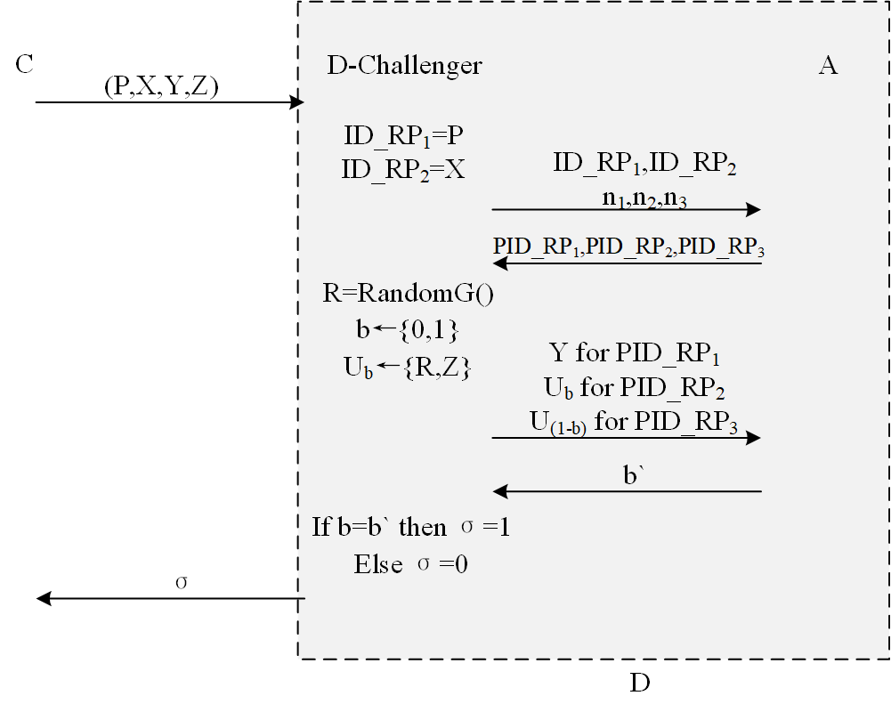
所以，若p2≠p3，则可以构造违反DDH假设的算法D

